Slide 1
FAST JOURNEY
Berk Muslu, Neslihan Özgün, Orkun Hacılar, Selçuk Talha Kul

Slide 2


THIS IS THE SPECIAL LOGO WE DESIGNED

Slide 3

WHAT IS THE FAST JOURNEY ?
We are a transportation company. We work with multiple brands and allow you to use multiple transportation vehicles, the most popular of which are planes and trains. There is a search engine to use our application more easily and access the data you want more easily. At the same time, the more active you are, the more coupons you can earn. In addition, our system uses automatic learning to find out what kind of things you are interested in and present that kind of things to you.

Slide 4
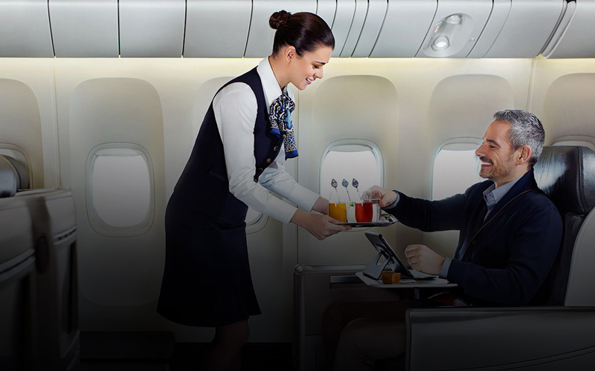
WHO ARE WE ?
We are a transportation company founded by four close friends. We are small entrepreneurs who have decided to open this company to make their transportation needs more comfortable.

Slide 5
PROJECT STAFFING
Software Project Manager: Software project manager is responsible for planning and scheduling the project, managing the team members and etc. The owner of this task is Neslihan Özgün.
Documentation Specialist: She will have the responsibility of maintenance of company documents. They are responsible for storage, cataloging and retrieval of documents. They maintain the integrity of working documents and update documentation when revised. The owner of this task is Neslihan Özgün.
Requirements Engineer: Requirements engineer is resposible for identifying the stakeholders getting the requirements from the customers, elicitating, analyzing and documenting the software requirements. The owner of this task is Orkun Hacılar.
Lead Desinger: Lead designer is responsible for understanding design paradigms, specifying and explaining system architecture, implementing portions of the design, troubleshooting design and implementation problems. The owner of this task is Orkun Hacılar.

Slide 6
PROJECT STAFFING
Tool Specialist: Tool specialist is responsible for understanding and troubleshooting possibly complex software installation and configuration, producing, distributing and explaining user information about software tools, reacting to critical and stressful software problems on short notice. The owner of this task is Selçuk Talha Kul.
Coder: Coder is responsible for understanding design documentation, system architecture and design decisions, coding, knowledge and understanding of development environment. The owner of this task is Berk Muslu.
Testers: Testers are responsible for the test planning and preparation phases of the testing, reviewing and contributing to test plans. Testers execute the tests, evaluate the results and document problems found. They monitor the testing and the test environment, often using tools for this task, and often gather performance metrics. The owners of this task are Berk Muslu and Selçuk Talha Kul.

Slide 7
WHO CAN USE FAST JOURNEY?
FAST JOURNEY is very helpful for tourists and travelers. Everybody can use this app easily because the design is basic and understandable.
Also, thanks to the coupon points earned while using the application, the users of the application have fun. And sometimes, thanks to the sweepstakes made by our company, we try to make our online users happy.

Slide 8
Why Should People Choose Us?
Ad-free Application Design
Easy Interface
Fast Access
Reliability
Cheap cost

Slide 9
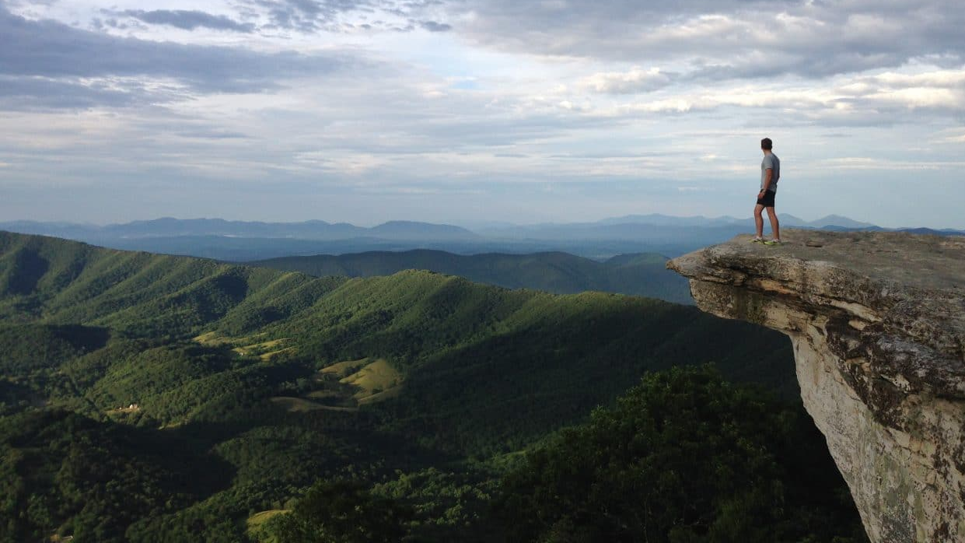
WHY DID WE CREATE FAST JOURNEY?
Because we created special surveys about people using other apps, and we identified some of the issues they complained about and worked on them such as purchase troubles, slow loading, etc.

Slide 10

What Is The Dream and Goal of This Company?
It is one of our biggest goals to reach a large number of users and keep them happy. Even if we do not reach the values ​​we want at the beginning, this is not a problem for our company because we are a company planning the future and we know that the main thing is the happy users.

Slide 11

What Will We Do To Reach You?
We know what time requires. So our main goal is to find easy ways to reach people. Obviously, the easiest way is social media accounts. We plan to run these accounts exclusively by social media content producers and reach the masses. We want to say that our target audience is young because we think that our users will spread our application better even if the users who use our site are in the middle age group. If we look at the time, many parents learn something from their children.

Slide 12


Slide 13
Functional Requirements
To buy ticket, users need to sign up.
Users can buy tickets at different areas (such as flight, bus etc).
There will be sign for verified accounts.
Announcements for events.
Users can make rezervation and cancel them.
Different options to pay
Users can transfer their tickets to other people.
Users can search tickets using restrictions
Users can compare tickets between each other
You can chat with the sellers

Slide 14
Non-Functional Requirements
Tests for program reliability.
Database will support up to 2,5 millions users.
Users can not sign up Fast Journey if they are under 18.
For privacy, users can not display another users which is not their friends.
For a good usability, we prepare a survey to gather feedback from users.
For the security, users password contain capital and lower case, numbers and special characters with a condition that each password contain at least 10 characters.

Slide 15
STAKEHOLDERS
Trade Unions
Communities
Creditors
Investors
Employees
Governments
Partners
Customers
Internal Stakeholders

Slide 16
SOFTWARE PROCESS MODEL
In this project, waterfall development process is going to be used;
The Waterfall Model was first Process Model to be introduced. It is also referred to as a linear-sequential life cycle model. It is very simple to understand and use. In a waterfall model, each phase must be completed fully before the next phase can begin. This type of software development model is basically used for the project which is small and there are no uncertain requirements.

Slide 17
The reason to choose the waterfall model because we are beginners and we can be confused while developing step. Without a good documentation, problems can go somewhere that we can not solve. Otherwise, we find appropriate the model and there is no reason to not choose the waterfall.

Slide 18
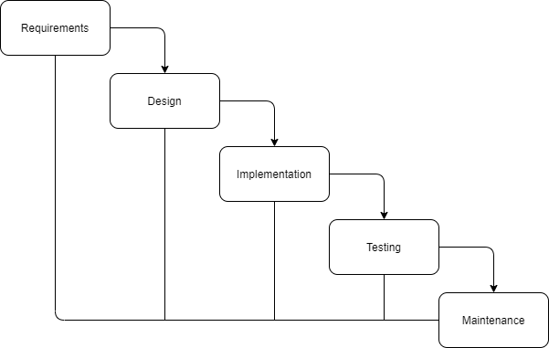
WATERFALL PROCESS MODEL

Slide 19
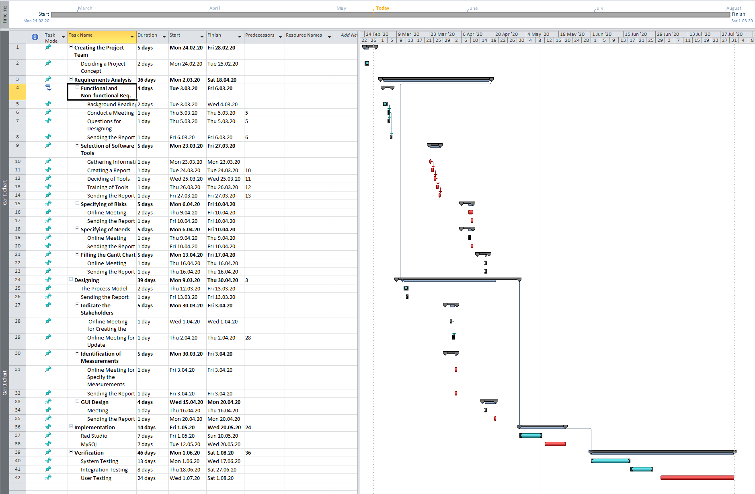
SCHEDULE AND EFFORT
Schedule and Gantt Chart of the Project

Slide 20
MEASUREMENTS
Schedule and Effort
Code Quality
Financial Risk
Technical Debt
Project Cost
Documents

Slide 21
PROJECT RISKS

Slide 22
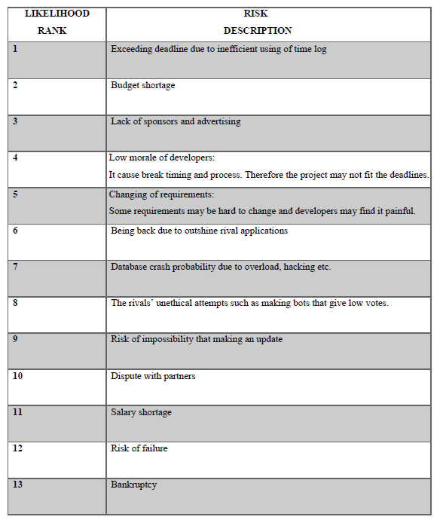
Likelihood Rank

Slide 23
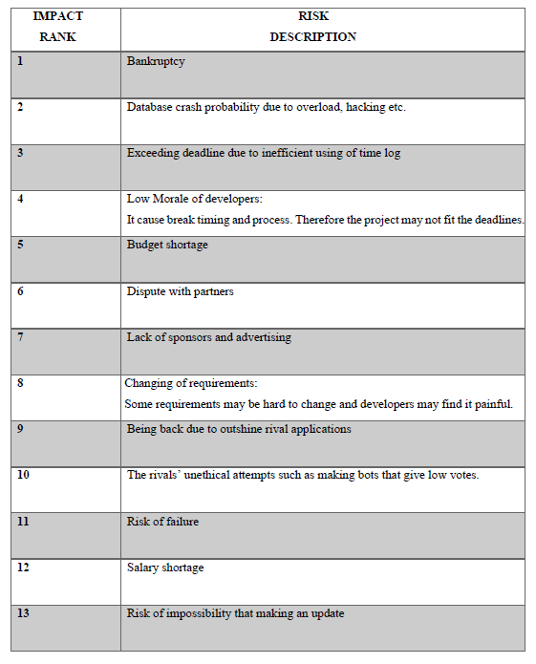
Impact Rank

Slide 24
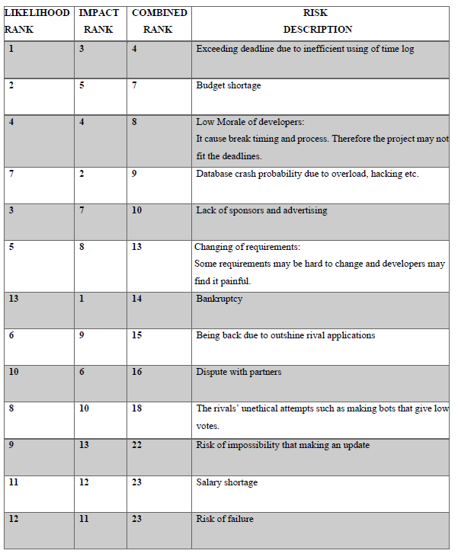
Combined Rank

Slide 25
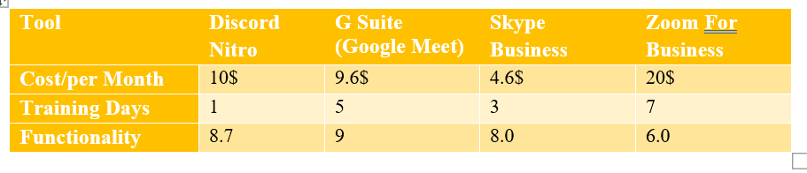
SOFTWARE TOOLS
Software tools are chosen according to the comparison graph. As an example for one of the chosen tools are as follows;
1. Tool Cost/Training/Functionality Data

Slide 26
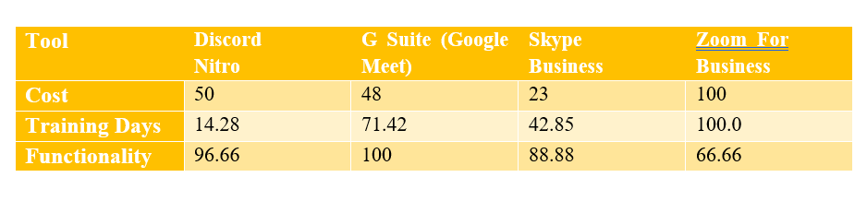
SOFTWARE TOOLS
2. Normalized Cost/Training/Functionality Data

Slide 27
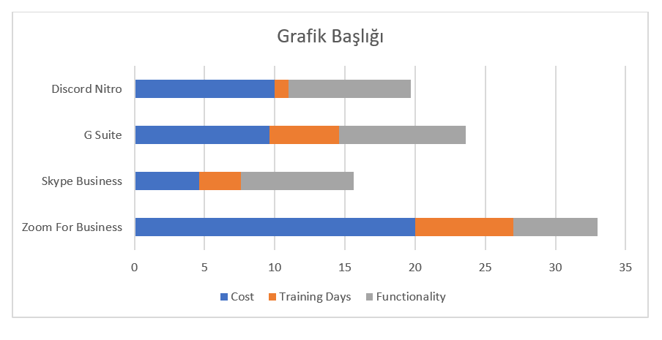
SOFTWARE TOOLS
3. Normalized Tool Graph

Slide 28

PROJECT NEEDS
Software Needs
• Operating Systems : Windows 10
• IDE: Rad Studio 10.3
• Code Libraries: RX, IPWorks (Delphi)
• Software Tools: Google Meet, MySQL
• Email Systems: Gmail

Slide 29

Hardware Needs
Computer: Each developer has own computer.
Data Storage Unit: WD Elements 10TB 3.5
Wireless Router: Zyxel WRE6602
Printer: Canon G3400

Slide 30
Support Needs
Travelling Companies: Success of this project helps these companies so they should support us.
Tour Companies: Success of this project helps these companies so they should support us. They can provide travel destination, tour programs for customers and etc.
Donators: Donators should support us financially.
Sponsors: Sponsors support us financially. They can provide travel destination.

Slide 31
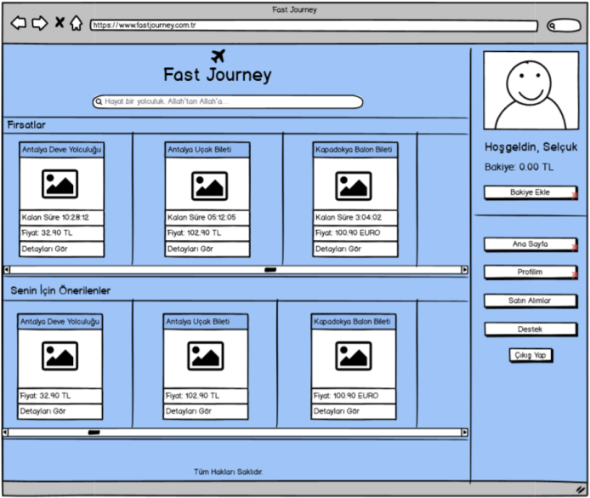
GRAPHICAL USER INTERFACES

Slide 32
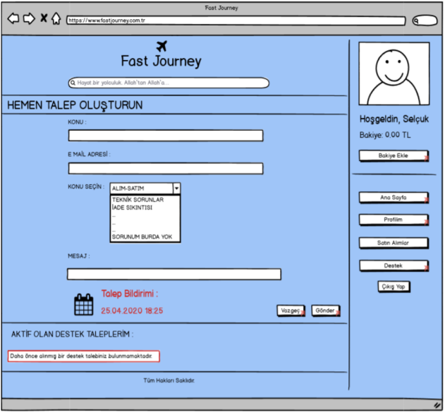
GRAPHICAL USER INTERFACES

Slide 33
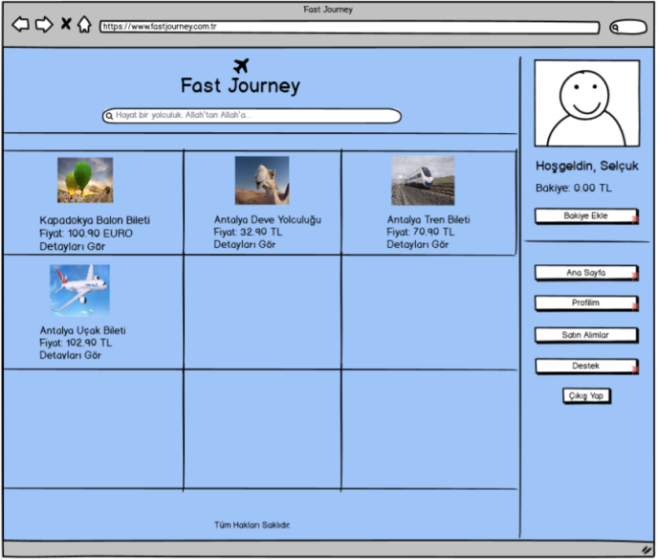
GRAPHICAL USER INTERFACES

Slide 34
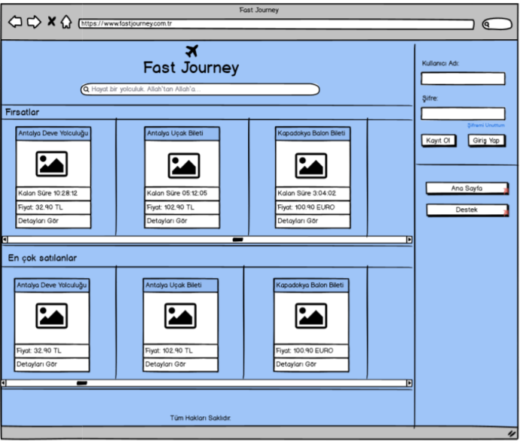
GRAPHICAL USER INTERFACES

Slide 35
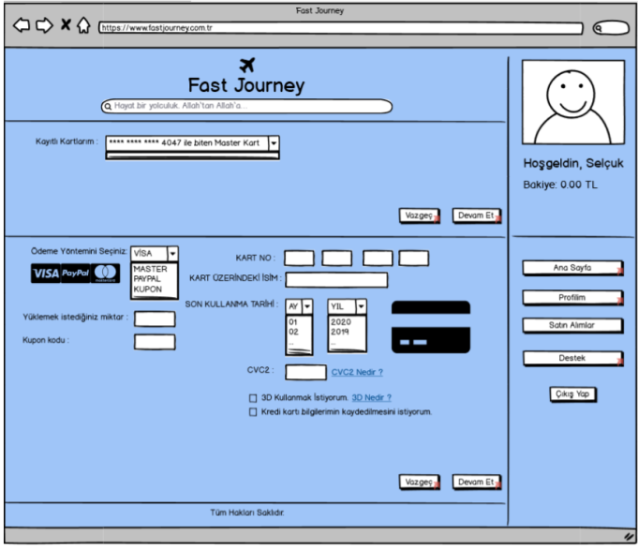
GRAPHICAL USER INTERFACES

Slide 36
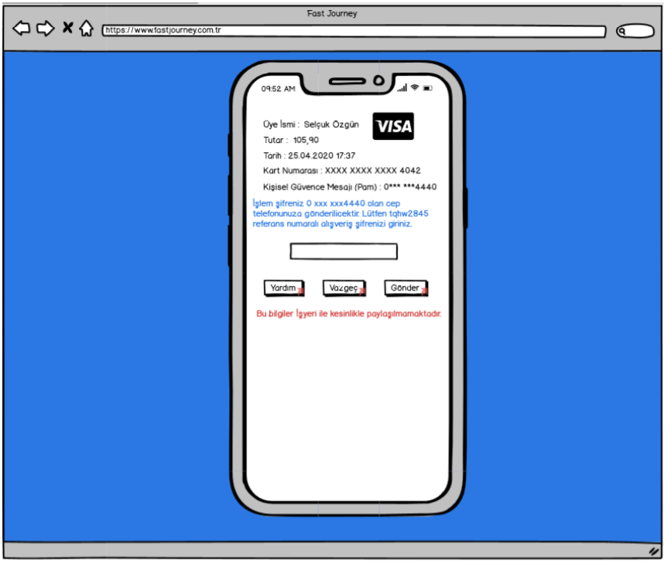
GRAPHICAL USER INTERFACES

Slide 37

Did You See?
Maybe you noticed, maybe you did not notice, but we try to be in people's brains by putting our logo in each slide for you to remember more easily. Although it looks like a small event, these kinds of things are important for brand popularity. With some little tactics like this and so on, we will reach our audience easier and cheaper.

Slide 38


